Slide 1
Autopilot literature review
Cairo University - Faculty of Engineering
Aerospace Department
Notes:
We designed this template so that each member of the project team has a set of slides with its own theme. Members, here’s how you add a new slide to just your set:
Mark where you want to add the slide: Select an existing one in the Thumbnails pane, click the New Slide button, then choose a layout. The new slide gets the same theme as the other slides in your set.
Careful! Don’t annoy your fellow presenters by accidentally changing their themes. That can happen if you choose a different theme from the Design tab, which changes all of the slides in the presentation to that look.

Slide 2
Team 15
Submitted To: Eng . Mahmoud Elewa
Name | Sec | Bn
Abdallah Ahmed Abdallah | 1 | 31
Mohamed Rajeh Mohamed | 2 | 10
Mohamed Rabie Walaan | 2 | 11
Ahmed Ramadan Kamal | 1 | 5
Mohamed Ahmed Mohamed Khalil | 2 | 5
Mohamed Emad Mahmoud | 2 | 20

Slide 3
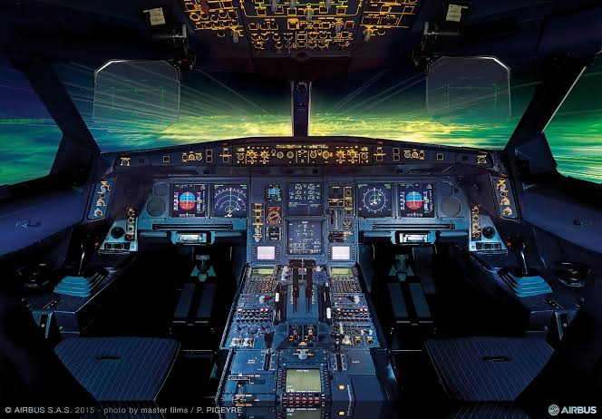
Introduction
Definition of Autopilot: A system that controls an aircraft under certain conditions using hydraulic, mechanical, and electronic systems.
Purpose: Helps pilots manage flight, maintain stability, and follow a predefined route.
Used mostly in passenger aircraft.

Slide 4
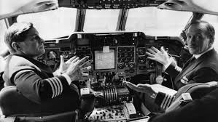
First Autopilot Invention
Invented in 1912 by Elmer Ambrose Sperry.
First tested successfully in 1914
Used gyroscopes to maintain stability.

Slide 5
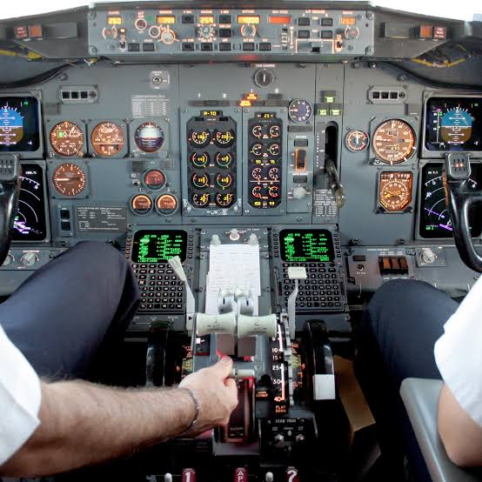
Inputs & Outputs of an Autopilot System
Inputs: GPS, gyroscope, airspeed sensor, magnetometer, accelerometer, LIDAR, sonar.
Outputs: Controls ailerons, rudder, elevators through servo actuators.
Integrated into Flight Management System (FMS).

Slide 6
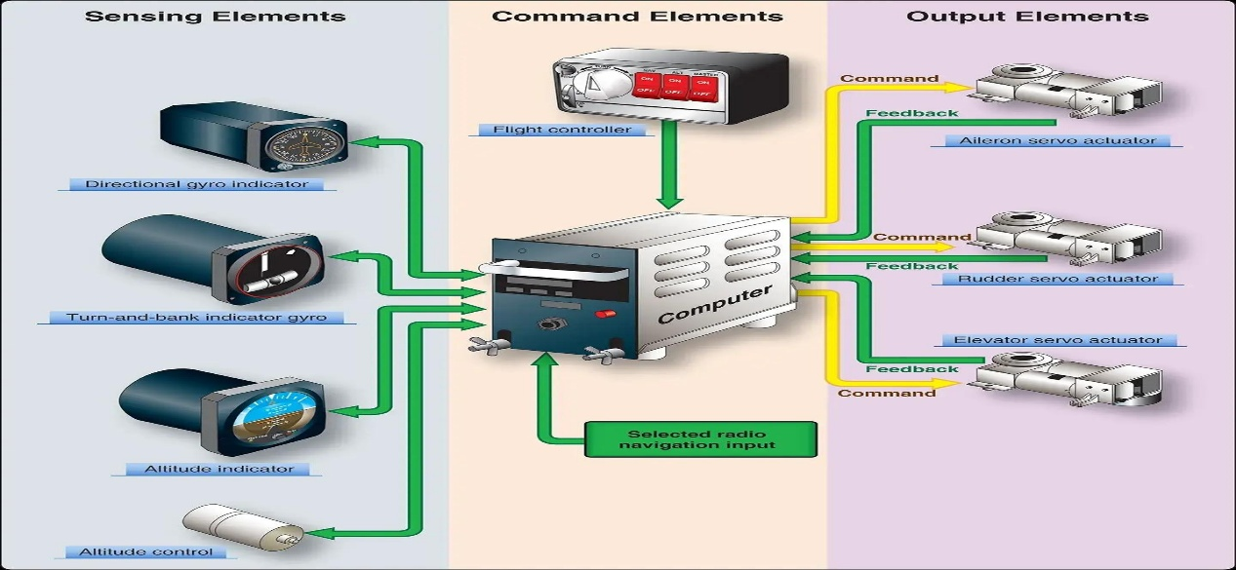
Autopilot Buttons & Controls
Key controls:
FD (Flight Director)
HDG (Heading)
NAV (Navigation)
ALT (Altitude)
APPR (Approach)
LVL (Level flight)

Slide 7
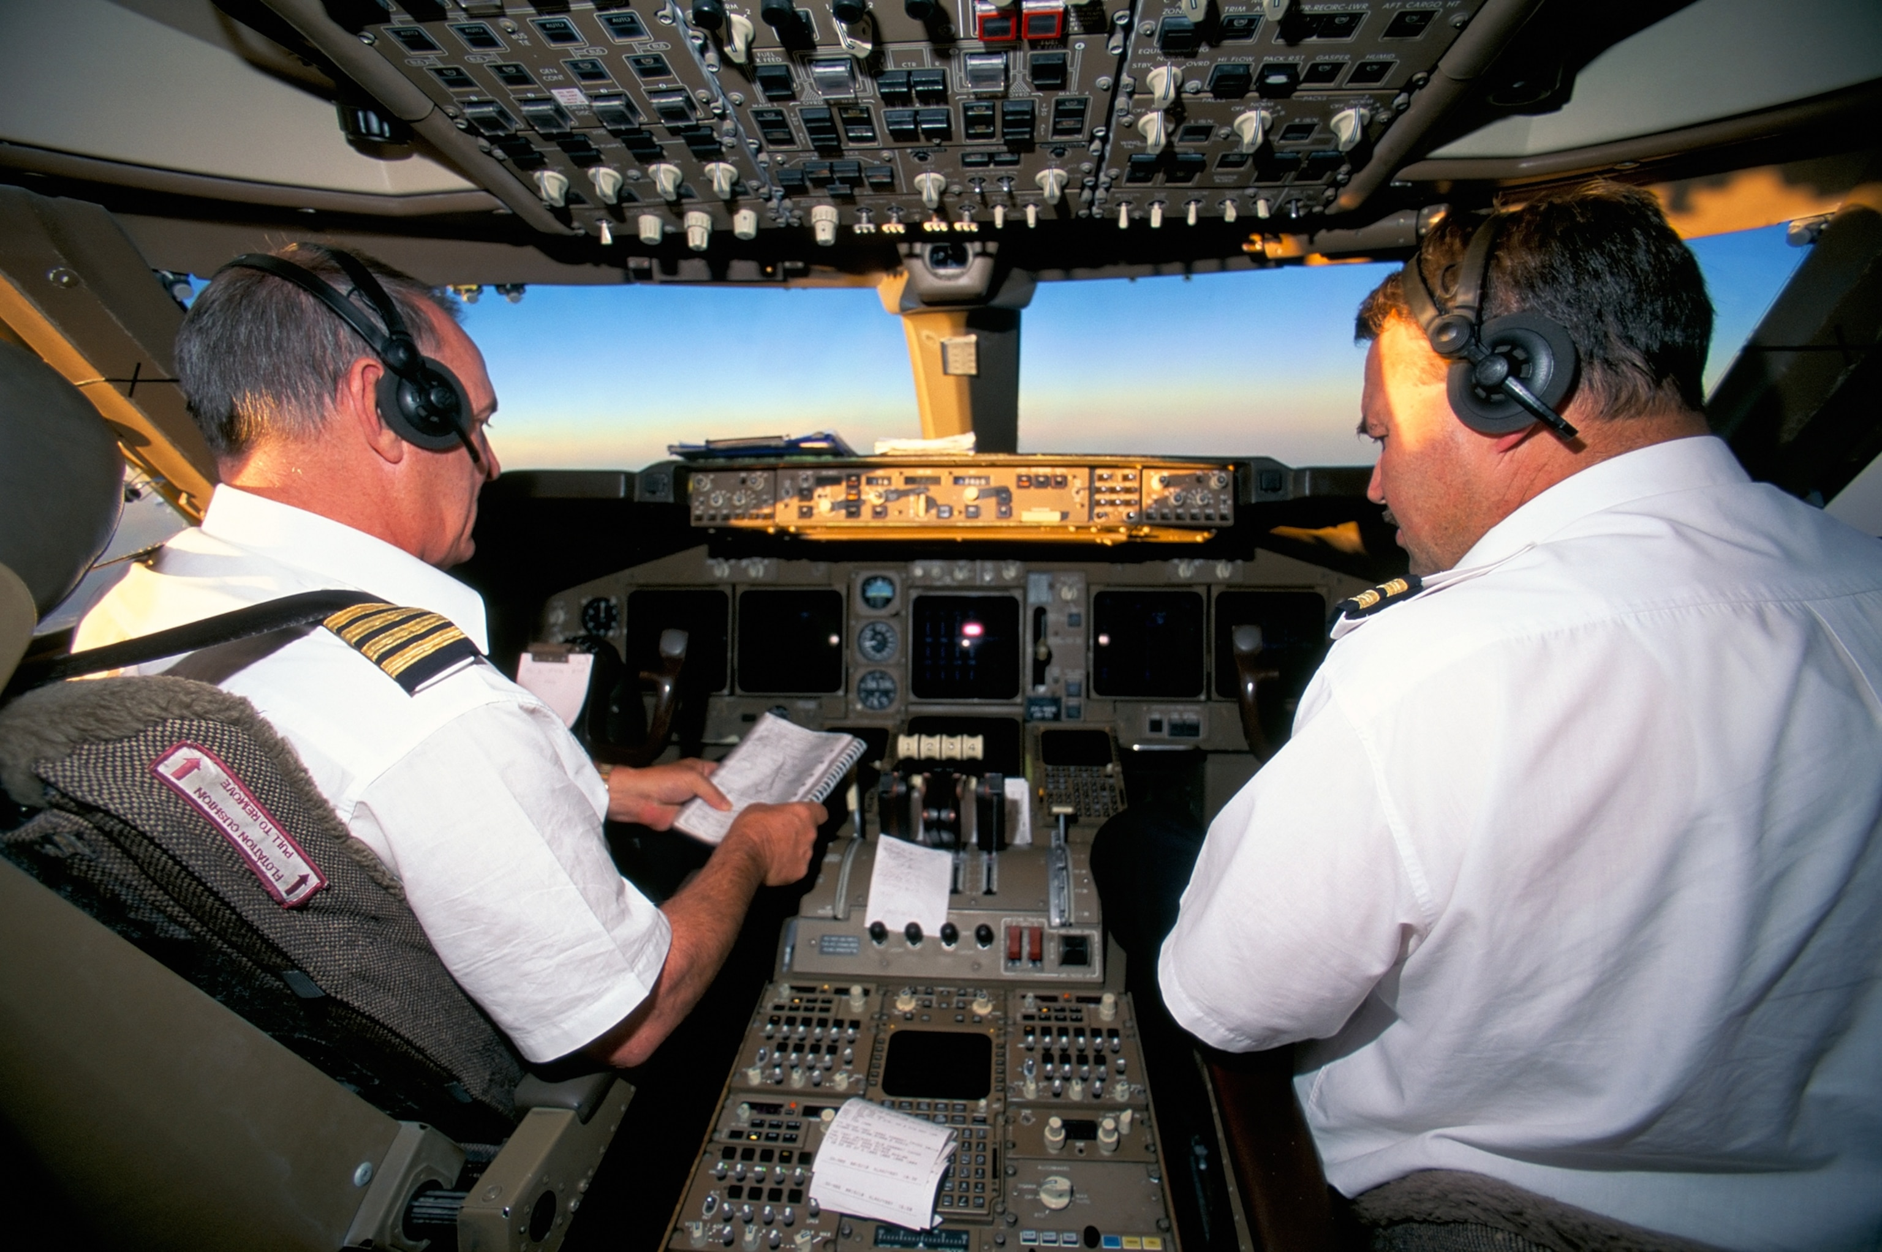
Role of the Pilot in an Autopilot System
Pilot inputs route into the system before takeoff.
Autopilot manages most of the flight but not taxiing or initial takeoff.
Some systems allow for automated landing.

Slide 8
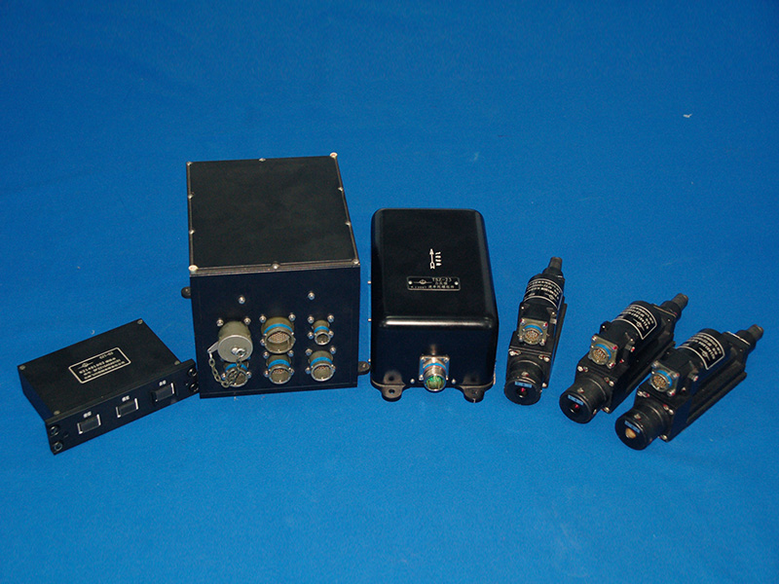
Autopilot vs. Stability Augmentation System (SAS)
SAS: Helps maintain stability (used in helicopters).
Autopilot: Manages full control of flight.
Both improve safety and efficiency.

Slide 9
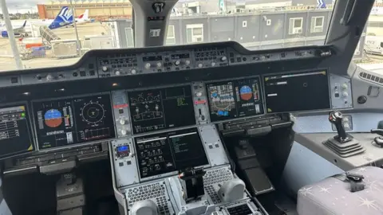
Onboard Sensors in Autopilot
GPS: Position and velocity.
Gyroscope: Angular velocity.
Airspeed Sensor: Measures dynamic pressure.
Magnetometer: Determines heading.
LIDAR & Sonar: Altitude and proximity.

Slide 10
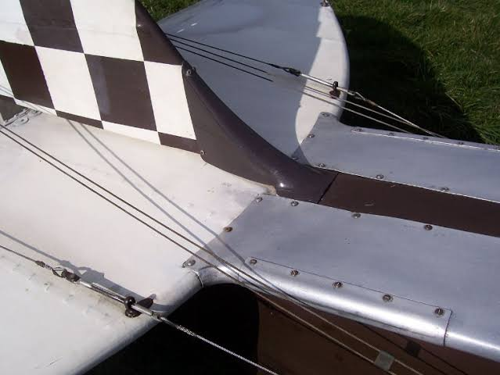
Flight Control Systems (Fly-by-Wire)
Replaces mechanical linkage with electrical signals.
Improves safety and reduces weight.
First fully implemented in the F-16 (1973).

Slide 11
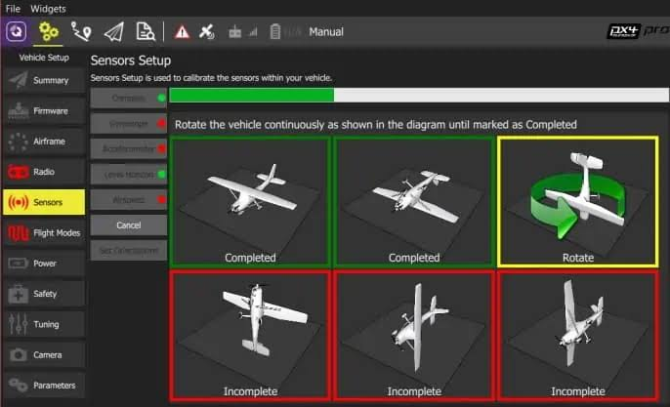
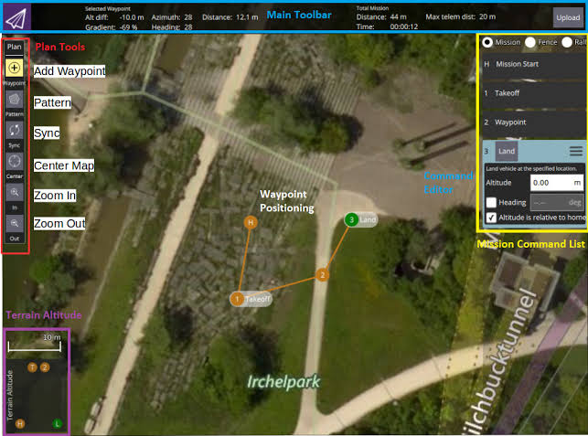
Open-Source Autopilot Software
PX4, Dronekit, and ArduPilot are widely used for UAVs.
Helps with UAV navigation and automation.

Slide 12
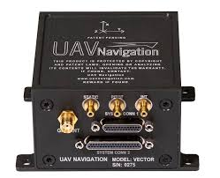
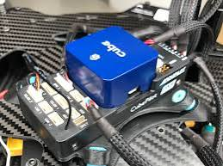
Autopilot Hardware for UAVs
VECTOR-600: High reliability and sensor redundancy.
Pixhawk Series: Popular for drone autopilots.

Slide 13
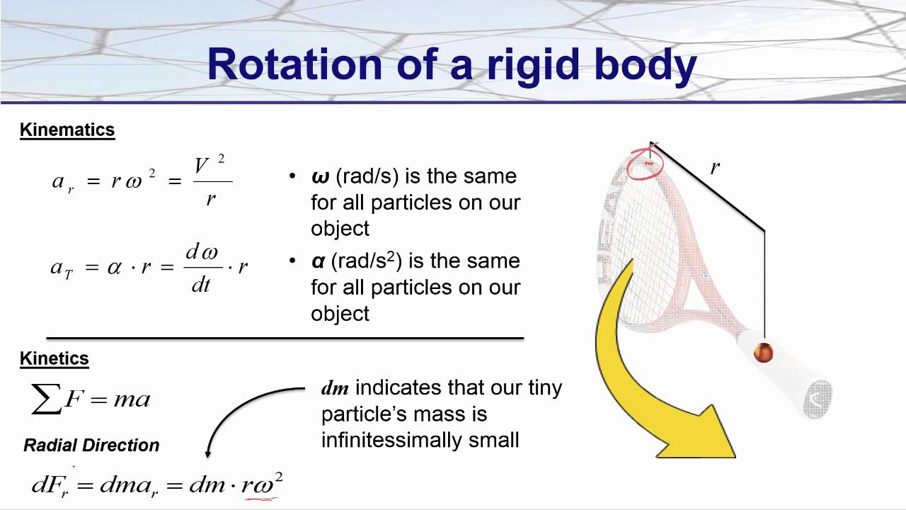
Flight Mechanics & Equations of Motion (EOM)
Rigid Body Dynamics (RBD) equations describe motion.
EOM includes translational & rotational motion.
Various mathematical representations: Euler angles, DCM, Quaternions.

Slide 14
Additional Concepts in Flight Mechanics
Pitch Angle vs. Angle of Attack:
Pitch angle: Angle between the aircraft and the horizon.
Angle of attack: Angle between airflow and the wing chord line.
Sideslip Angle vs. Heading Angle:
Sideslip: Measures yaw misalignment.
Heading: Direction relative to North.

Slide 15
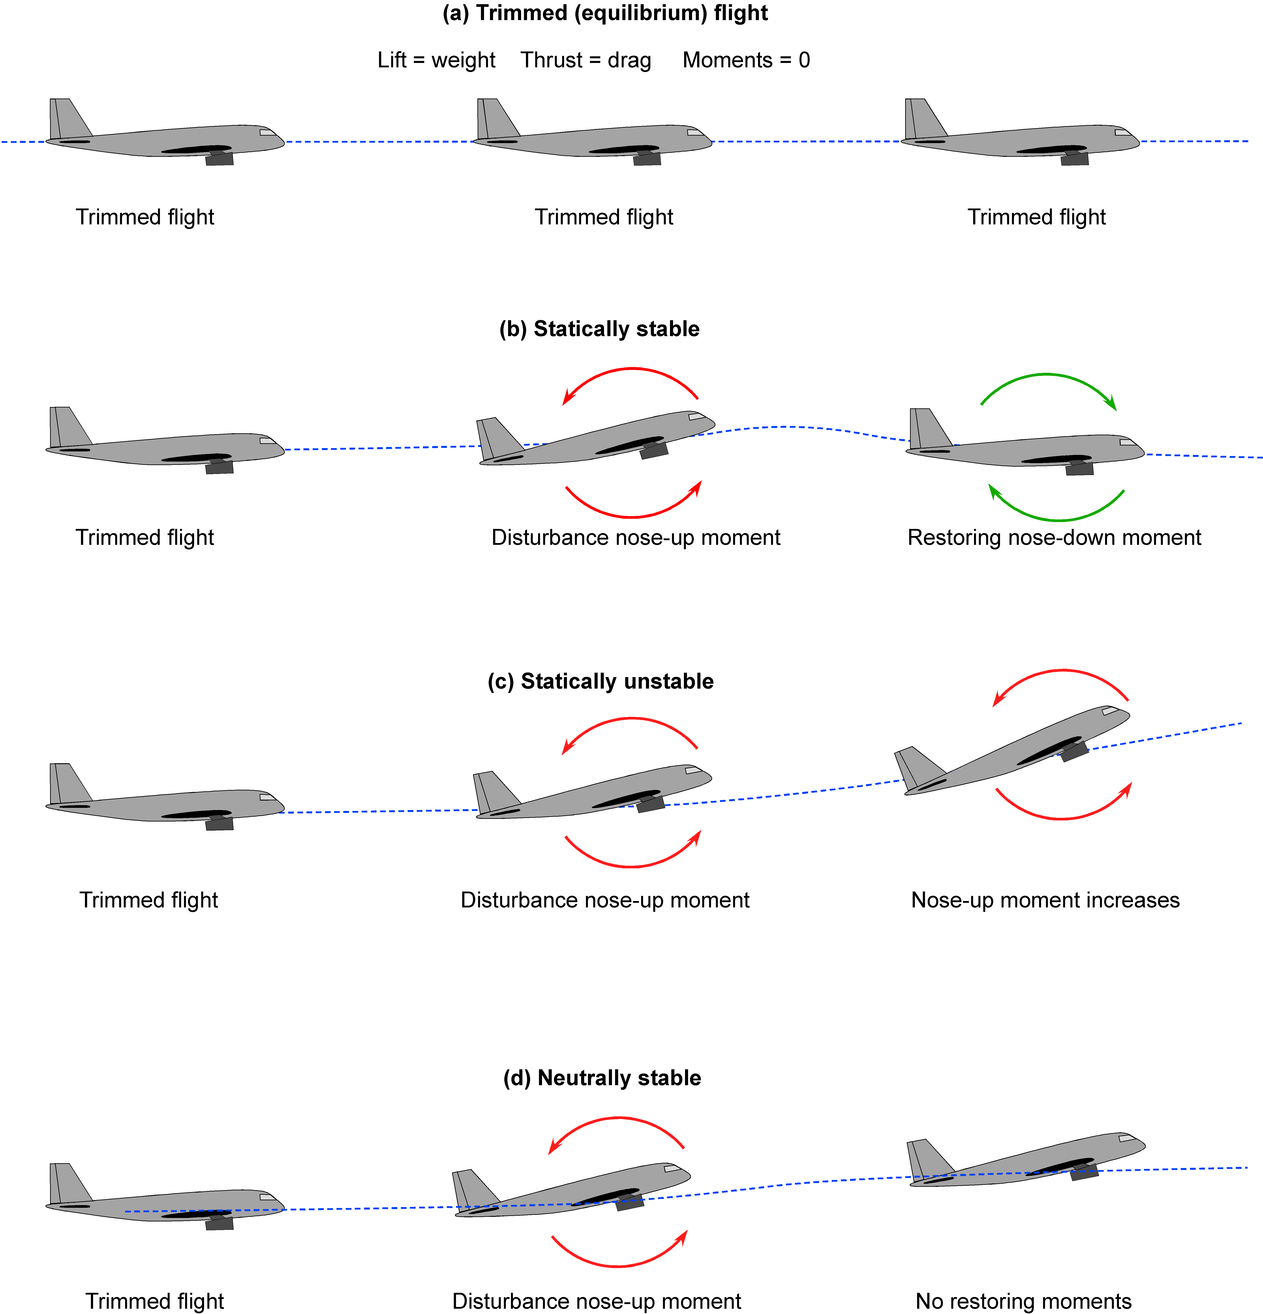
Stability and Control in Flight Mechanics
Longitudinal Stability: Ensures pitch stability.
Lateral Stability: Helps maintain wings-level flight.
Directional Stability: Maintains straight flight without yaw drift.
Control Surfaces: Elevator, ailerons, rudder, and their roles in stability.

Slide 16
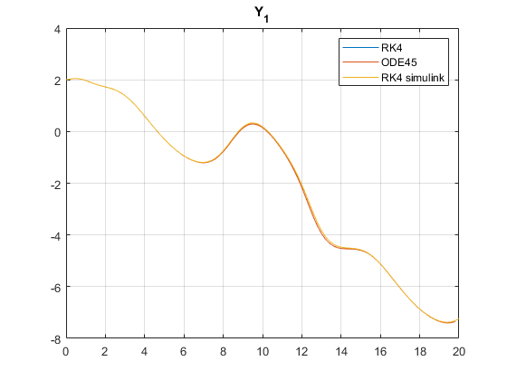
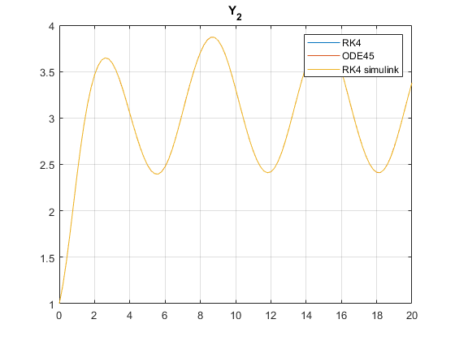
Numerical Solutions of Equations of Motion
Methods used:
Euler’s Method
Runge-Kutta (RK4)
ODE45 (used in MATLAB simulations)
RK4 is commonly used for aircraft motion simulation.

Slide 17
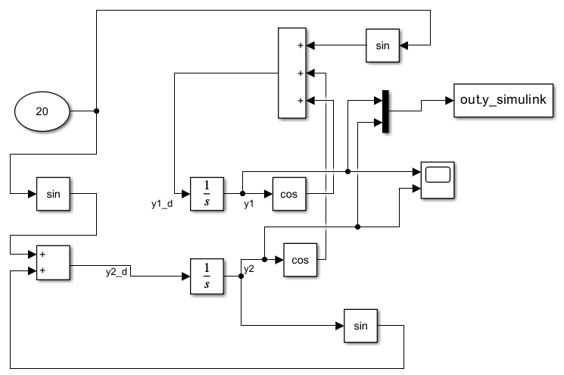
Simulink model

Slide 18
Conclusion
Autopilot systems enhance flight safety and efficiency.
Key components: sensors, control algorithms, and feedback mechanisms.
Continuous advancements improve automation and precision in aviation.

